Slide 1

Troutwood Brand
story

Slide 2

Brand Identity Prism
“If the brand was a human being, who will it be”.
PHYSIQUE
Troutwood Logo Font w/ Tree and w/o Tree
Varying shades of Troutwood green, black, white
Clean
RELATIONSHIP
Safe space
Relieving
Accessible
Trustworthy
REFLECTION
Willing to learn
Young
Seeking financial stability
PERSONALITY
Friendly, with open ears
Knowledgeable, Trustworthy
Actively helpful and informative
Fun!
CULTURE
Supportive
Sincere
Friendly
Dedicated
SELF IMAGE
Capable
Organized
Well versed
Empowered
“Characteristics of your typical customer”
“What do I feel when I use the brand?”

Slide 3
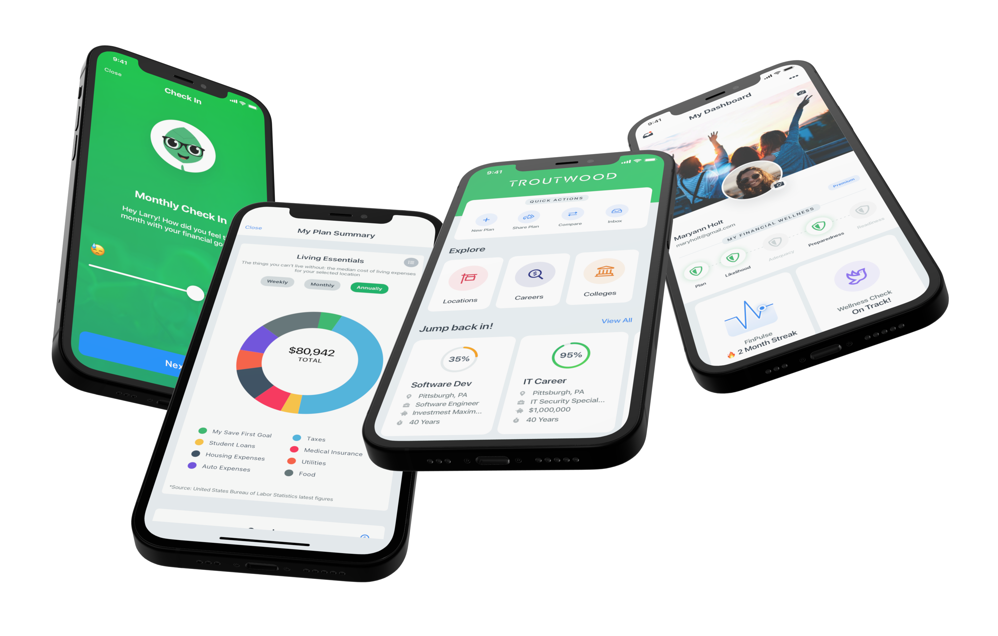
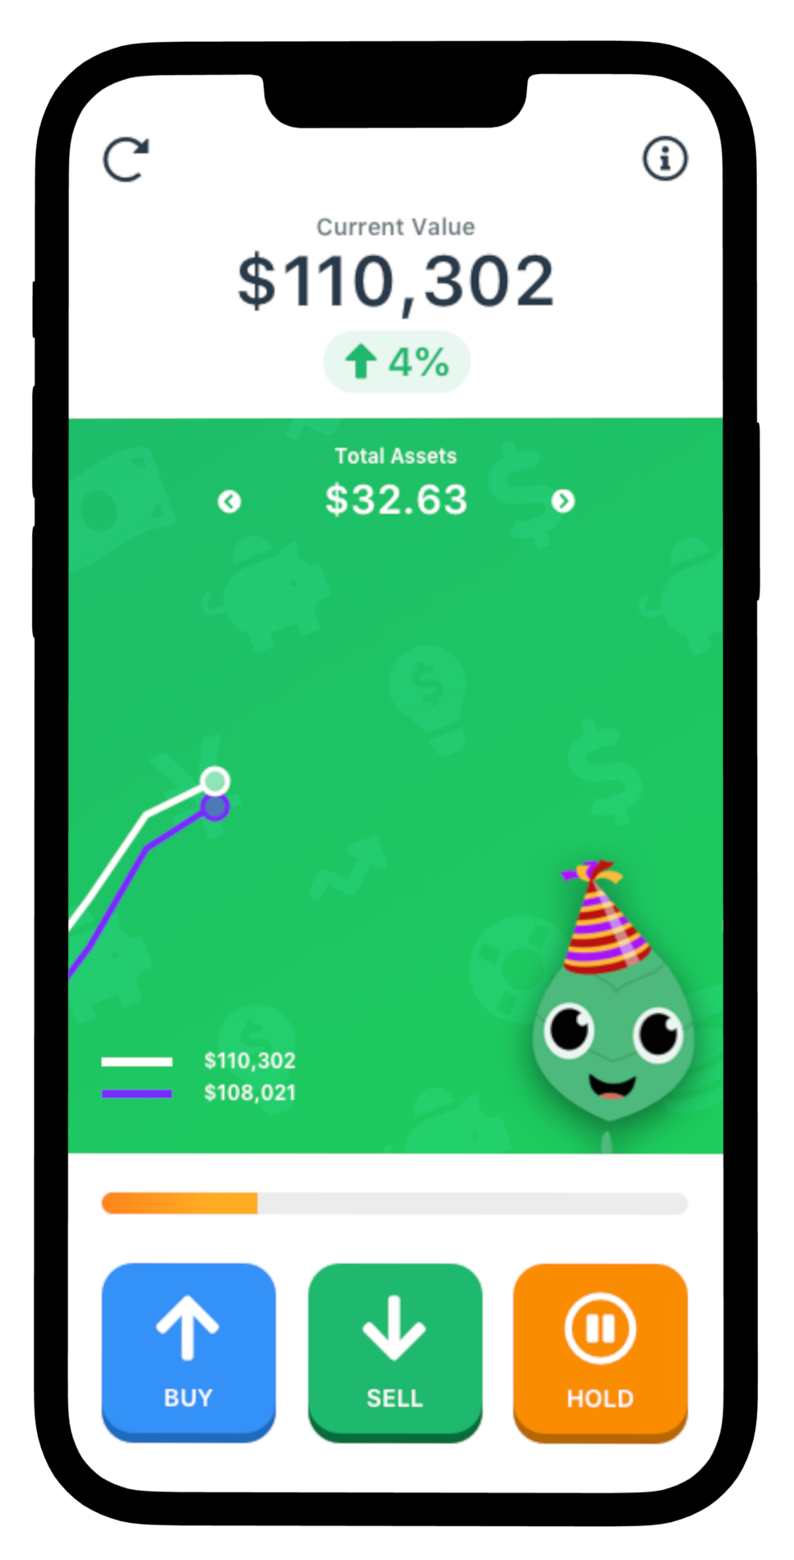
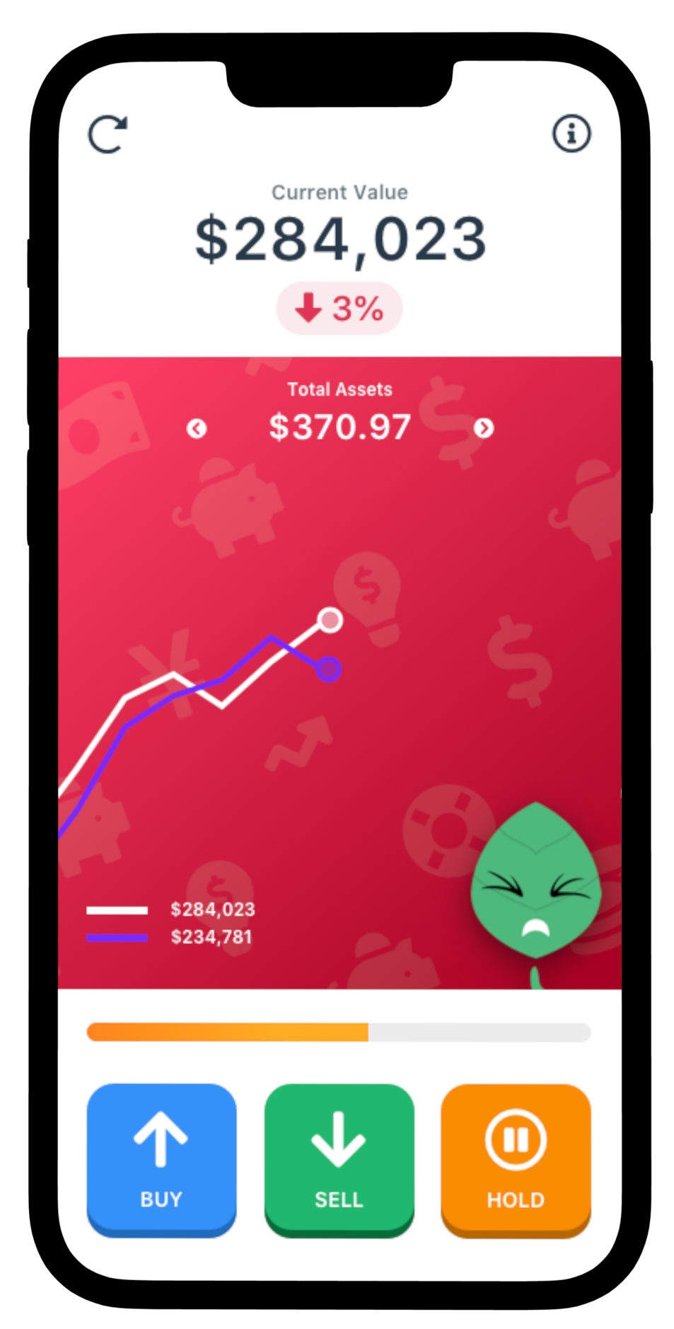
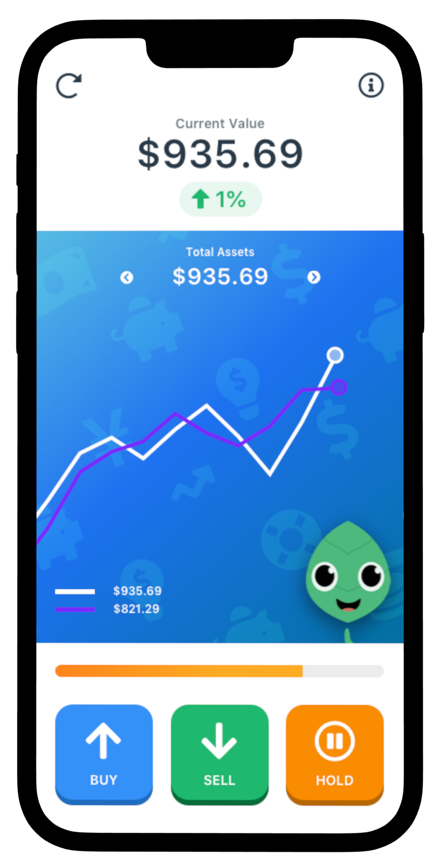
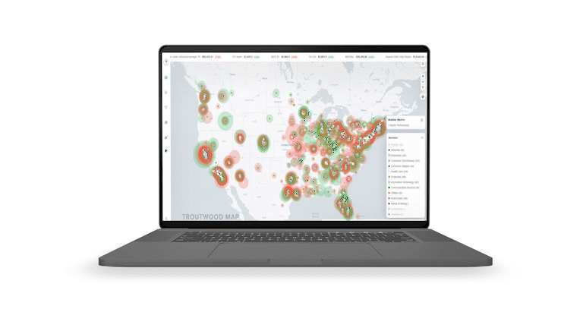

Website

Slide 4
Socials
“Troutwood – Create your first financial plan.”
Conversations about current events
Interactions with customers and people
Tips & quotes
Announcements

Slide 5
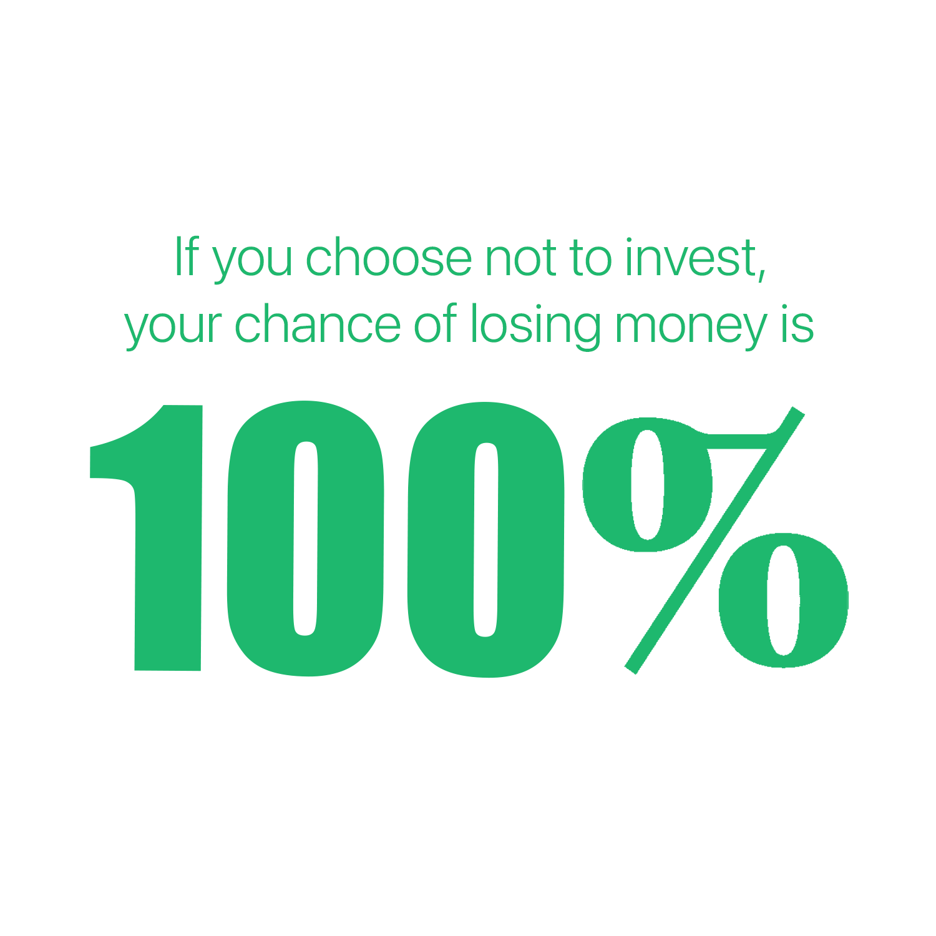
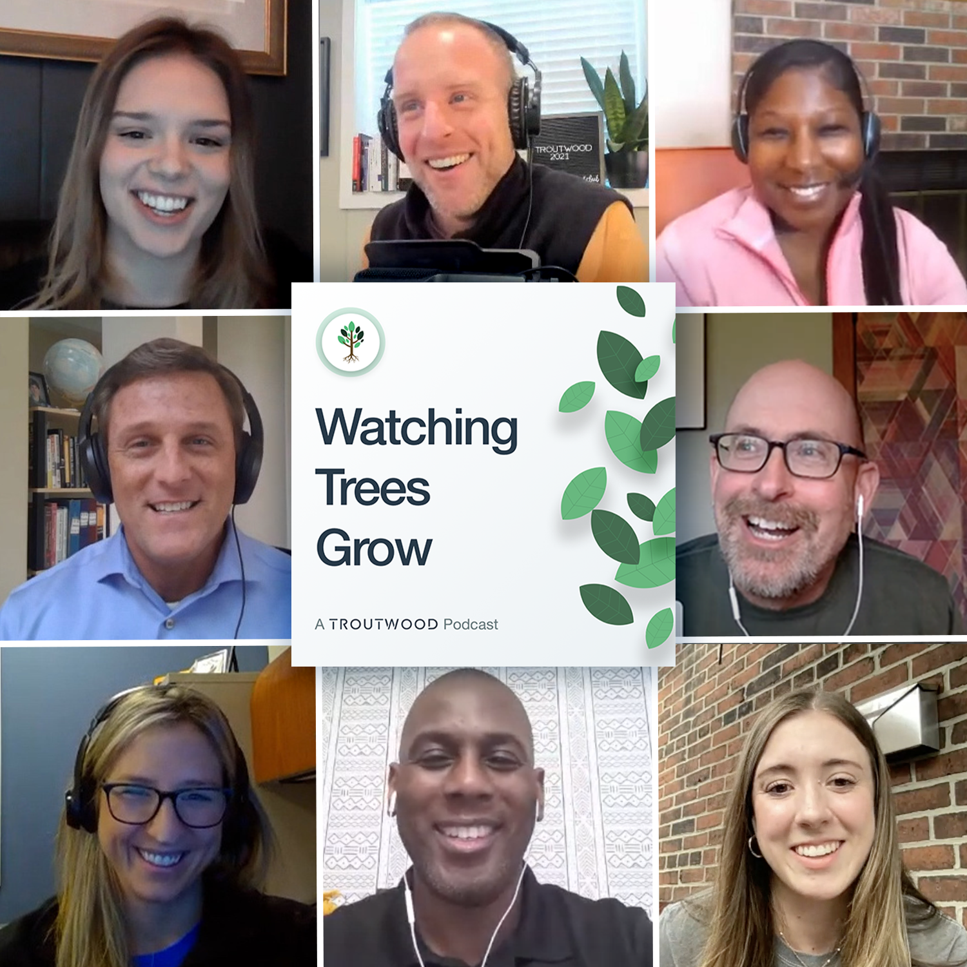
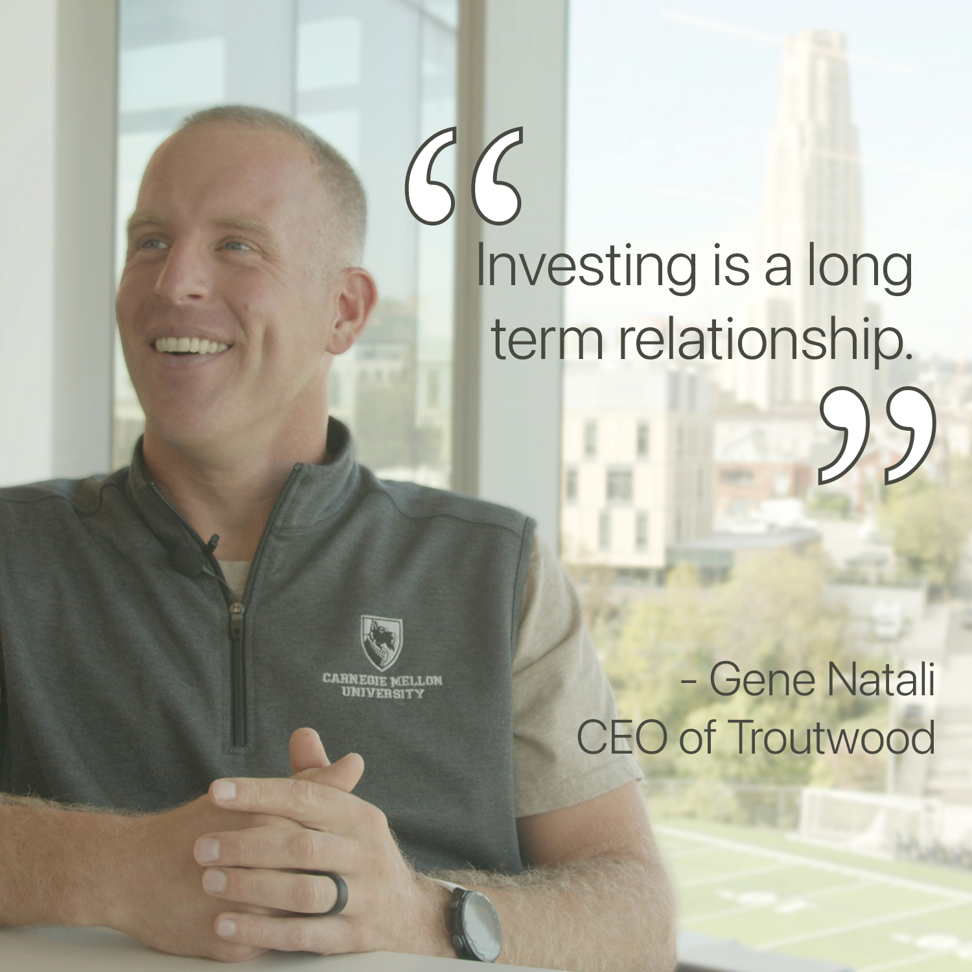

Instagram/Facebook
People, Products, Quotes
SF Pro, Bebas Neue, occasional pop font

Slide 6
Youtube

Slide 7
Twitter
Connection between Gene & Troutwood – each should repost the other’s tweets
This provides a connection between our CEO and our brand as a whole

Slide 8
Linkedin

Slide 9
Reels

Slide 10
TikTok

Slide 11
Messaging

Slide 12
Content

